Slide 1

Who Is Dying and Why?
AIDS Mortality as a Progress Metric
Sharonann Lynch
HIV & TB Policy Advisor
MSF Access Campaign

Slide 2
OUTLINE
Trends in mortality
Finding the RIPs among the LTFU
Who is dying and why
Preventing senseless deaths
Why corrected mortality rates matter

Slide 3
1. Trends in mortality

Slide 5
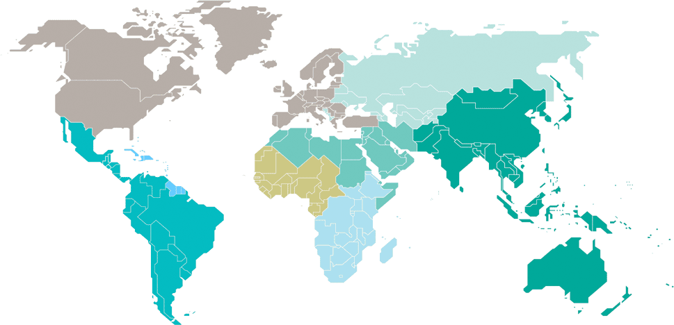
Estimated adult and child deaths from AIDS  2017
Eastern Europe
and central Asia
34 000
[25 000–41 000]
North America and western and central Europe
13 000
[9900–18 000]
Caribbean
10 000
[7100–17 000]
Middle East and North Africa
9800
[6400–15 000]
Western and central Africa
280 000
[180 000–410 000]
Asia and the Pacific
170 000
[110 000–280 000]
Latin America
37 000
[26 000–51 000]
Eastern and southern Africa
380 000
[300 000–510 000]
Total: 940 000 [670 000–1.3 million]
On mortality in EECA, Middle East, North Africa:
There has been no reduction in AIDS-related mortality in eastern Europe and central Asia since 2010, and deaths from AIDS-related illness increased by 11% in the Middle East and North Africa.
Mortality reductions remain higher among women than men. This gender gap is particularly notable in sub-Saharan Africa, …more men living with HIV are dying
Outside of sub-Saharan Africa, 69% deaths from AIDS-related illness were among men and boys.
SOURCE: UNAIDS

Slide 6
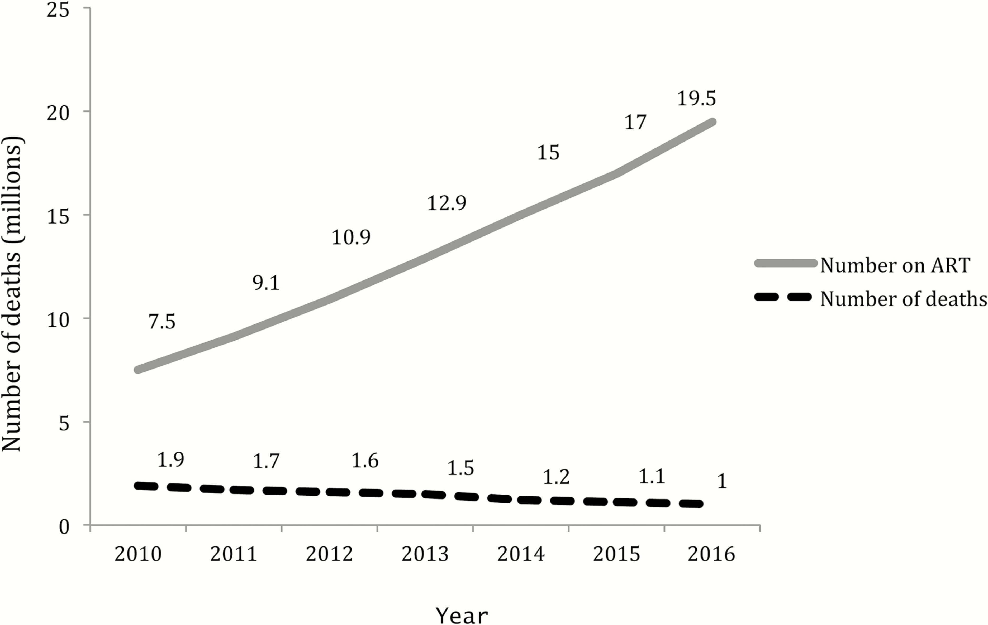
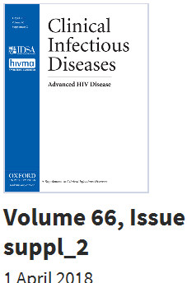
Challenge: reach as many people as possible, as quickly as possible, as early in their disease progression as possible
Number of patients receiving ART and number of deaths.
SOURCE: The Persistent Challenge of Advanced HIV Disease and AIDS in the Era of Antiretroviral Therapy. Clin Infect Dis. 2018;66(suppl_2):S103-SS105. doi:10.1093/cid/cix1138
Notes:
Figure 1. Number of patients receiving ART and number of deaths. Abbreviation: ART, antiretroviral therapy.
Clin Infect Dis | © 2018 World Health Organization; licensee Oxford University Press USA.This is an open access article distributed under the terms of the Creative Commons Attribution IGO License (http://creativecommons.org/licenses/by/3.0/igo/legalcode), which permits unrestricted use, distribution, and reproduction in any medium, provided the original work is properly cited. In any reproduction of this article there should not be any suggestion that WHO or this article endorse any specific organisation or products. The use of the WHO logo is not permitted. This notice should be preserved along with the article’s original URL.
6

Slide 7
HIV deaths in South Africa, with and without ART
Johnson LF, May MT, Dorrington RE, Cornell M, Boulle A, Egger M, et al. (2017) Estimating the impact of antiretroviral treatment on adult mortality trends in South Africa: A mathematical modelling study. PLoS Med 14(12): e1002468.

Slide 8
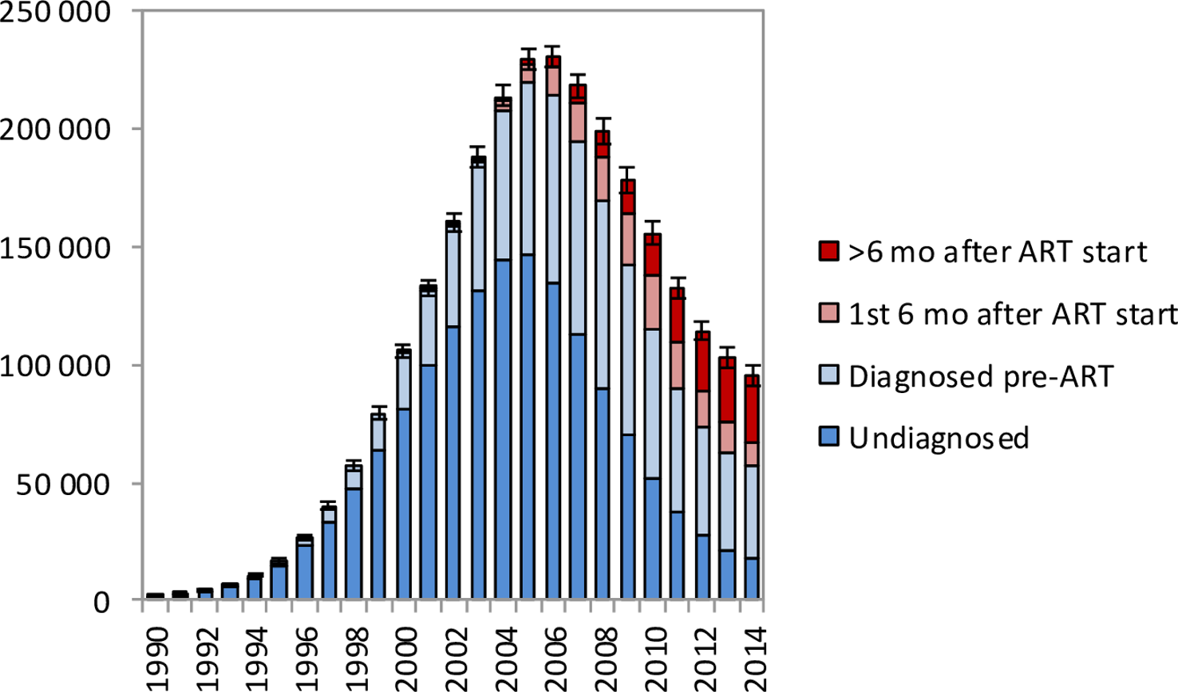
In 2014, estimated
18.3% (95% CI: 17.2%–19.5%) adult HIV deaths in undiagnosed individuals
41.7% (95% CI: 34.6%–48.0%) diagnosed but ART-naïve
10.2% (95% CI: 8.6%–11.9%) <6 months of ART
29.8% (95% CI: 24.6%–36.2%) >6 months of ART
Est adult HIV deaths in 2014:
18.3% undiagnosed individuals
41.7% diagnosed but ART-naïve
10.2% <6 months of ART
29.8% >6 months of ART
HIV-related deaths in adults for the years 1990–2014 by level of engagement in HIV care
Estimating the impact of antiretroviral treatment on adult mortality trends in South Africa: A mathematical modelling study.
Johnson LF, May MT, Dorrington RE, Cornell M, Boulle A, Egger M, et al. (2017) Estimating the impact of antiretroviral treatment on adult mortality trends in South Africa: A mathematical modelling study. PLoS Med 14(12): e1002468.
Notes:
In 2014, estimated
18.3% (95% CI: 17.2%–19.5%) adult HIV deaths in undiagnosed individuals
41.7% (95% CI: 34.6%–48.0%) diagnosed but ART-naïve
10.2% (95% CI: 8.6%–11.9%) <6 months of ART
29.8% (95% CI: 24.6%–36.2%) >6 months of ART
Fig 3. HIV-related deaths in adults for the years 1990–2014 by level of engagement in HIV care.
Bars represent posterior means from the main analysis. Error bars represent 95% confidence intervals around model estimates of total HIV-related deaths in adults.
https://doi.org/10.1371/journal.pmed.1002468.g003

Slide 9
2. Finding the RIPs among the LTFU

Slide 10
LTFU and RIPs
From IeDEA
505,634 patients
  12,848 (2.5%) from Central Africa10
  9,233 (21.6%) from East Africa
  347,343(68.7%) from Southern Africa
  36,210 (7.2%) from West Africa
In crude analyses of observed clinic data,
  52.1% retained on ART
  41.8% were lost to follow-up
  6.0% had died 5 years after ART initiation
After accounting for undocumented deaths and self-transfers, we estimated that 66.6% of patients were retained on ART, 18.8% had stopped ART and 14.7% had died at 5 years
Andreas D Haas AD, Zaniewski E, Anderegg n, et al. Retention and mortality on antiretroviral therapy in sub-SaharanAfrica: collaborative analyses of HIV treatment programmes. Journal of the International AIDS society [Online]. 2018 [Cited 2018 Jul 20]. Available from: https://onlinelibrary.wiley.com/doi/epdf/10.1002/jia2.25084
Notes:
Andreas D Haas AD, Zaniewski E, Anderegg n, et al. Retention and mortality on antiretroviral therapy in sub-SaharanAfrica: collaborative analyses of HIV treatment programmes. Journal of the International AIDS society [Online]. 2018 [Cited 2018 Jul 20]. Available from: https://onlinelibrary.wiley.com/doi/epdf/10.1002/jia2.25084

Slide 11
Tracing loss to follow up
4 years after the last clinic visit
21.8% known RIP
  (95% CI, 20.8%–22.7%)
31.6% could not been found
  (95% CI, 30.6%–32.7%)
22.6% alive but stopped ART
  (95% CI, 21.6%–23.6%)
14.8% transferred out
  (95% CI, 14.0%–15.6%)
9.2% remaining in care
  (95% CI, 8.5%–9.8%)
9 studies tracing 7,377 PLWHA on ART considered LTFU across 8 sub-Saharan countries
Chammmartin F, Zurcher K, Keiser O, et al. Outcomes of Patients Lost to Follow-up in African Antiretroviral Therapy Programs: Individual Patient Data Meta-analysis. Clin Infect Dis [Online]. 2018 Jun 8.
Notes:
[Cited 2018 Jul 15]. Available from: https://doi.org/10.1093/cid/ciy347
Outcomes were analyzed using cumulative incidence functions and proportional hazards models for the competing risks of (i) death, (ii) alive but stopped cART, (iii) silent transfer to other clinics, and (iv) retention on cART. Results. Nine studies contributed data on 7377 patients who started cART and were subsequently LTFU in sub-Saharan Africa. The median CD4 count at the start of cART was 129 cells/μL. At 4 years after the last clinic visit, 21.8% (95% confidence interval [CI], 20.8%–22.7%) were known to have died, 22.6% (95% CI, 21.6%–23.6%) were alive but had stopped cART, 14.8% (95% CI, 14.0%–15.6%) had transferred to another clinic, 9.2% (95% CI, 8.5%–9.8%) were retained
Mortality was associated with male sex, more advanced disease, and shorter cART duration; stopping cART with less advanced disease and longer cART duration; and silent transfer with female sex and less advanced disease.

Slide 12
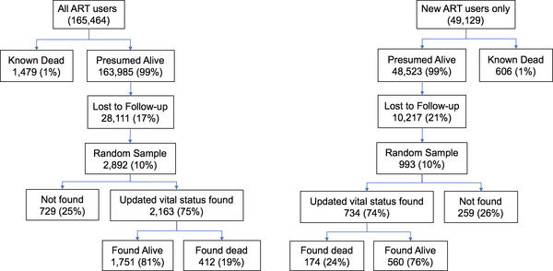
Zambia CDC
Used a representative sampling-based approach to assess mortality among PLWHA on ART
Samples representing over 165,464 ppl across 4 provinces over a 24 month period (2013-2015)
Findings
Marked variability across geographical areas
High site-to-site variability
Holmes CB, Sikazwe I, Sikombe K, et al. Estimated mortality on HIV treatment among active patients and patients lost to follow-up in 4 provinces of Zambia: Findings from a multistage sampling-based survey. PLoS Med. 2018;15(1):e1002489.
Notes:
https://doi.org/10.1371/journal.pmed.1002489
38.1% of deaths among PLWHA in first year on ART
50.3% deaths no history of missed visits
31.7% occurred among individuals while lost
61.8% among people on ART longer > 1 year
36.7% (95% CI 30.1%–43.8%) among individuals while lost
Holmes CB, Sikazwe I, Sikombe K, et al. Estimated mortality on HIV treatment among active patients and patients lost to follow-up in 4 provinces of Zambia: Findings from a multistage sampling-based survey. PLoS Med [Online]. 2018 [Cited 2018 July 13];15(1):e1002489. Available from: https://doi.org/10.1371/journal.pmed.1002489

Slide 13
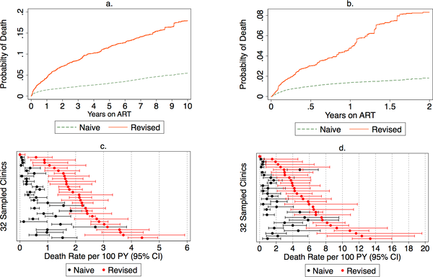
Naïve and revised mortality estimates
cumulative incidence of mortality among all ART users (N = 165,464)
Cumulative incidence of mortality among new ART users (N = 49,129)
Findings
38.1% of deaths among PLWHA in first year on ART
61.8% among people on ART longer > 1 year
Holmes CB, Sikazwe I, Sikombe K, Eshun-Wilson I, Czaicki N, et al. (2018) Estimated mortality on HIV treatment among active patients and patients lost to follow-up in 4 provinces of Zambia: Findings from a multistage sampling-based survey. PLOS Medicine 15(1): e1002489. https://doi.org/10.1371/journal.pmed.1002489
Notes:
http://journals.plos.org/plosmedicine/article?id=10.1371/journal.pmed.1002489

Slide 14
Intensive follow-up in Zambia corrects mortality figures
Facilities reporting high 2-year LTFU rates (40–50%)
“meaning that up to half of patients at particular sites had unknown outcomes.”
“passive reporting of deaths” - average of 15–20% of deaths are known to the facility
Found substantial underreporting of deaths. Revised numbers were 3 to 9 times higher.
Holmes CB, Sikazwe I, Geng E. We need to monitor mortality to improve public health programs: here’s why and how to do it. International Health [Online]. 2018 Jul 17.
Notes:
Holmes CB, Sikazwe I, Geng E. We need to monitor mortality to improve public health programs: here’s why and how to do it. International Health [Online]. 2018 Jul 17 [Cited 2018 Jul 18]. Available from: https://doi.org/10.1093/inthealth/ihy039.
“meaning that up to half of patients at particular sites had unknown outcomes.”

Slide 15
3. Who is dying

Slide 16
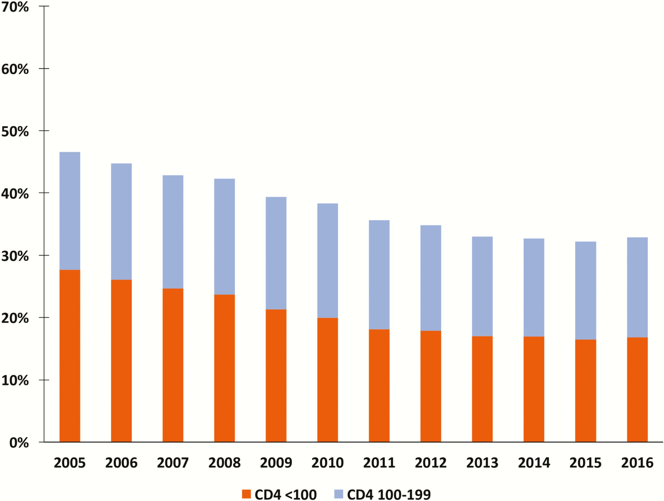
Among 654,868 PLWHA entering care in 2016 in South Africa:
- Almost a third (32.9%) had advanced HIV disease
- 16.8% had very advanced HIV disease
- Men almost twice as likely as women (23.1% vs 12.6%) to enter care with very advanced HIV disease.
Proportion of PLWHA presenting with CD4 counts <200, <100, and <50 cells/µL has stayed roughly the same since 2010 (IeDEA and COHERE: among 951,855 PLWHA,
across 55 countries)
IeDEA and COHERE Cohort Collaborations. Global Trends in CD4 Cell Count at the Start of Antiretroviral Therapy: Collaborative Study of Treatment Programs. Clin Infect Dis 2018; Jan 25.
Proportion entering care with advanced and very advanced HIV disease (2004-2016) in RSA
Osler M, Hilderbrand K, Goemaere E et al. The Continuing Burden of Advanced HIV Disease Over 10 Years of Increasing Antiretroviral Therapy Coverage in South Africa. Clin Infect Dis. 2018;66(suppl_2)
Carmona S et al. Persistent High Burden of Advanced HIV Disease Among Patients Seeking Care in South Africa’s National HIV Program: Data From a Nationwide Laboratory Cohort. Clin Infect Dis. 2018;66(suppl_2)
Notes:
Carmona S, Bor J, Nattey C, et al. Persistent high burden of advanced HIV disease among patients seeking care in South Africa’s National HIV program: Data from a nationwide laboratory cohort. Clin Infect Dis [Online]. 2018 Mar 4[Cited 2018 Jul 13 ];66(Suppl 2). Available from: https://academic.oup.com/cid/article/66/suppl_2/S111/4918994?searchresult=1
IeDEA and COHERE Cohort Collaborations. Global Trends in CD4 Cell Count at the Start of Antiretroviral Therapy: Collaborative Study of Treatment Programs. Clin Infect Dis 2018; Jan 25.
Figure 1. Proportion of patients entering care with advanced and very advanced HIV disease (first CD4 count test <100 and 100–199 cells/µL).
From: Persistent High Burden of Advanced HIV Disease Among Patients Seeking Care in South Africa’s National HIV Program: Data From a Nationwide Laboratory Cohort
Clin Infect Dis. 2018;66(suppl_2):S111-S117. doi:10.1093/cid/ciy045
Clin Infect Dis | © 2018 World Health Organization; licensee Oxford University Press USA.This is an open access article distributed under the terms of the Creative Commons Attribution IGO License (http://creativecommons.org/licenses/by/3.0/igo/legalcode), which permits unrestricted use, distribution, and reproduction in any medium, provided the original work is properly cited. In any reproduction of this article there should not be any suggestion that WHO or this article endorse any specific organisation or products. The use of the WHO logo is not permitted. This notice should be preserved along with the article’s original URL.
16

Slide 17
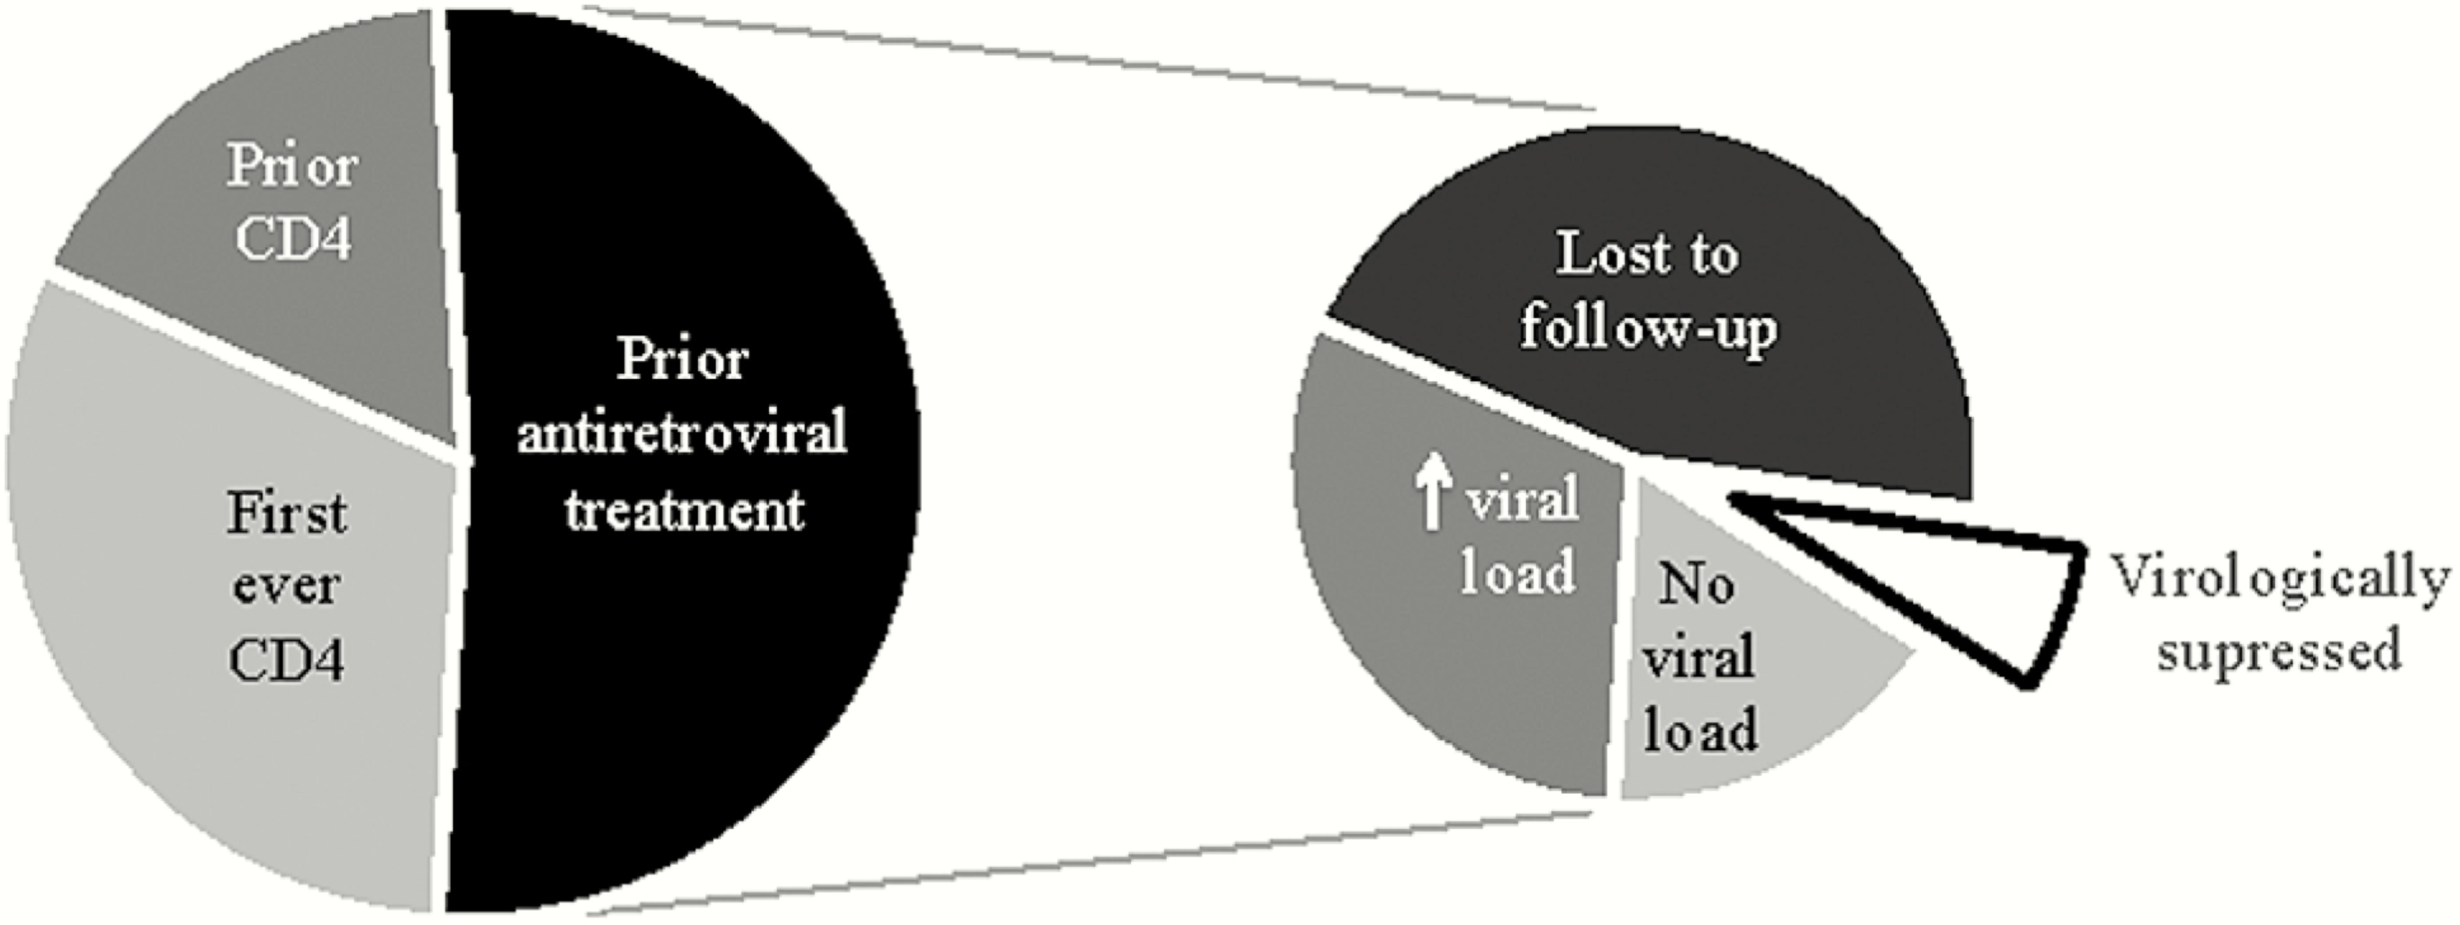
(South Africa) Increased proportion of PLWHA presenting in 2016 with CD4<50 are ART experienced: from 14.3% in 2008 to 56.7% in 2017
Figure: Distribution of prior CD4 count testing, antiretroviral therapy (ART), ART retention, and recent virologic status in PLWHA presenting in 2016 with a CD4 count <50 cells/µL, Western Cape province, South Africa
Osler M, Hilderbrand K, Goemaere E et al. The Continuing Burden of Advanced HIV Disease Over 10 Years of Increasing Antiretroviral Therapy Coverage in South Africa. Clin Infect Dis. 2018;66(suppl_2):S118-S125. doi:10.1093/cid/cix1140
Notes:
Figure 3. Distribution of prior CD4 count testing, antiretroviral therapy (ART), ART retention, and recent virologic status in patients presenting in 2016 with a CD4 count <50 cells/µL, Western Cape province, South Africa.
From: The Continuing Burden of Advanced HIV Disease Over 10 Years of Increasing Antiretroviral Therapy Coverage in South Africa
Clin Infect Dis. 2018;66(suppl_2):S118-S125. doi:10.1093/cid/cix1140
Clin Infect Dis | © 2018 World Health Organization; licensee Oxford University Press USA.This is an open access article distributed under the terms of the Creative Commons Attribution IGO License (http://creativecommons.org/licenses/by/3.0/igo/legalcode), which permits unrestricted use, distribution, and reproduction in any medium, provided the original work is properly cited. In any reproduction of this article there should not be any suggestion that WHO or this article endorse any specific organisation or products. The use of the WHO logo is not permitted. This notice should be preserved along with the article’s original URL.
17

Slide 18
Admission profile by ART status in 4 referral units hospitals supported by MSF
Notes:
EC: High proportion in our cohorts in-hospital of experienced ART patients
Ai remplace GF Jooste par Donka : donnees plus recentes

Slide 19
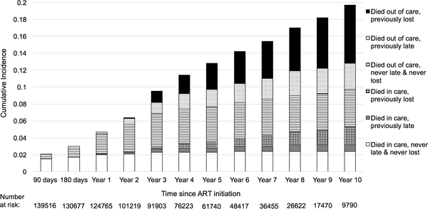
Among newly starting treatment deaths:
50.3% no history of missed visits
14.0% while late
31.7% while lost
Among longer on ART deaths:
8.8% always in care, at RIP
13.7% late history (but in care at RIP)
29.1% in care but lost history
11.7% while late
36.7% while lost
Fig 3. Proportion of patients who died after starting antiretroviral therapy (ART) by engagement status, with left truncation for individuals on ART before the study observation period (N = 165,464).
Holmes CB, Sikazwe I, Sikombe K, Eshun-Wilson I, Czaicki N, et al. (2018) Estimated mortality on HIV treatment among active patients and patients lost to follow-up in 4 provinces of Zambia: Findings from a multistage sampling-based survey. PLOS Medicine 15(1): e1002489. https://doi.org/10.1371/journal.pmed.1002489
Notes:
http://journals.plos.org/plosmedicine/article?id=10.1371/journal.pmed.1002489
Lost was defined as having been more than 90 days late for a visit, and late was defined as being 15–90 days late for a visit.

Slide 20
4. Preventing senseless deaths

Slide 21
Lessons
Associated with mortality
  Male gender
  Low CD4 count at initiation
  Advanced disease
  Shorter time on ART
  Stopping ART (even with less advanced disease and longer ART)
What’s needed
  INTENSIVE CASE FINDING
  Outreach and early HIV diagnosis
  Better and rapid linkage to ART
  Men into early ART initiation
  Advanced HIV package of care
  Better adherence support
  POC tools
  INTENSIVE ACTIVE TRACING
  Welcome back to care…

Slide 22
TB FAIL
Between 2000 and 2016, “Among HIV-positive people, TB treatment supported by ART averted an additional 9 million deaths.” (Source WHO Global TB report)
In 2017 3 out of 5 people starting HIV treatment are not screened, tested or treated for TB (UNAIDS Miles to Go)
Globally, just 42% of people newly registered in HIV care were receiving tuberculosis preventive therapy.
Among the 124 countries that reported data to UNAIDS in 2016, only 39% of the estimated number of people living with HIV who had incident tuberculosis received treatment for both HIV and tuberculosis
Notes:
From global TB report 2017: http://apps.who.int/iris/bitstream/handle/10665/259366/9789241565516-eng.pdf?sequence=1

Slide 23
Non-negotiable package of OI/advanced HIV care at PHC and inpatient facilities to test/treat/prevent
→ tuberculosis
→ severe bacterial infections (SBI)
→ cryptococcal meningitis
→ toxoplasmosis
→ Pneumocystis jirovecii pneumonia (PCP)
Diagnostic | CD4
 | Sputum Xpert MTB/RIF
 | Urine TB-LAM
 | Cryptococcal antigen screening (CrAg)
Preventive | Cotrimoxazole
 | TB prophylaxis - CTX, isoniazid, & pyridoxine in FDC -3HP (3 months of weekly INH + rifapentine)
 | Antifungal preemptive therapy for CrAg positive)
Notes:
Frigati L, Archary M, Rabie H, Penazzato M, Ford N. Priorities for Decreasing Morbidity and Mortality in Children With Advanced HIV Disease. Clinical Infectious Diseases [Online]. 2018 Mar 4 [Cited 2018 Jul 15];66(Suppl 2). Available from: https://doi.org/10.1093/cid/ciy013

Slide 24
5. Why corrected mortality matters

Slide 25
“Young paediatric patients were at greater risk of early death, being almost twice as likely to die within 90 days.
Males were at greater risk of early death once initiated on ART (HR 1.35, 95% CI 1.09, 1.66))
Females in late adolescence were at greatest risk of death > 90 days after entering pre-ART/ART (HR 2.44 [1.60, 3.74] <0.01).
Late adolescents demonstrated greater non-engagement in care (RR 1.21 (95% CI 1.16, 1.26)).
Among both males and females, early paediatric and late adolescent groups experienced significantly greater loss to follow-up.”

Slide 26
Why corrected mortality matters
Systemic changes needed in measuring mortality
  Civil registration and vital statistics systems
Not “LTFU prevention,” but rather “death prevention”
Highlights gaps in equity, services, to inform better policy and corrective action
  “mortality across facilities ranged from 0 per 100 person years to 13.4 per 100 person years, even though the facilities in theory receive similar support”
  Needs of populations - Young paediatric and late adolescent age groups at increased risk of late diagnosis, early death, delayed treatment initiation and loss of continuity of care
More accurate reflection of the state of ART within the health system at national, provincial, an d facility levels
Notes:
Holmes: “While modeled estimates of mortality may be accurate enough for tracking broad trends at the national or global level, they offer limited utility for public health improvement efforts at individual clinics and hospitals or at the subnational level. “
ZAMBA: HIV deaths fell from 68,000 (2005) to 21,000 (2015)

Slide 27

Mbeki’s denialism and inaction resulted in more than 330,000 deaths in South Africa from 1999 to 2007
In the 2000–2014 period, if South Africa had moved swiftly to implement WHO guidelines
  2.20 million (95% CI: 2.00 million–2.37 million) fewer HIV-related deaths
  6.15 million life years that were actually saved and the 8.80 million life years that could have been saved
Chigwedere P, Essex M. AIDS denialism and public health practice. AIDS Behav. 2010;14(2):237–47
Johnson LF, May MT, Dorrington RE, Cornell M, Boulle A, Egger M, et al. (2017) Estimating the impact of antiretroviral treatment on adult mortality trends in South Africa: A mathematical modelling study. PLoS Med 14(12): e1002468. https://doi.org/10.1371/journal.pmed.1002468
Notes:
AIDS and Behavior. April 2010, Volume 14, Issue 2, pp 237–247 | Cite as. AIDS Denialism and Public Health Practice. Available from https://link.springer.com/article/10.1007%2Fs10461-009-9654-7
Kalichman SC. Pence, Putin, Mbeki and Their HIV/AIDS-Related Crimes Against Humanity: Call for Social Justice and Behavioral Science Advocacy. Editorial. AIDS and Behavior [Online]. 2017 Apr
[Cited 2018 Jul 13];21(4). Available from: https://link.springer.com/article/10.1007%2Fs10461-017-1695-8

Slide 28
Model-based comparison of different ”scale-back strategies” based on hypothetical reduction of international funding for HIV in South Africa and Côte d’Ivoire
  No New ART
  Late Presentation
  ART 0.350*10^9 cells/L
  reduced retention
  no viral load monitoring
  no 2nd line ART
For example, although a strategy of decreased case identification (Late Presentation) reduces the HIV program budget (RSA 13%, CI 13%), deaths are projected to increase (RSA 22%, CI 15%).
“reverse enormous strides made over the last 20 years in curbing the global HIV epidemic and in improving HIV-related survival.”
“Our findings suggest that reduced HIV foreign aid will produce modest savings to donors at the expense of HIV epidemic revival and massive loss of life among recipient nations.”
Walensky RP, Ethan D. Borre ED, et al. Do Less Harm: Evaluating HIV Programmatic Alternatives in Response to Cutbacks in Foreign Aid. Ann Intern Med [Online]. 2017
Notes:
[Cited 2018 Jul 13]. Available from: https://www.ncbi.nlm.nih.gov/pmc/articles/PMC5675810/

Slide 29
Thank you
For latest MSF reports, go to:
www.msf.org/aids-2018,
www.msfaccess.org/stopping-deaths
sharonann.lynch@msf.org
Acknowledgements: MSF Field Teams, Jess Burry, Emmanuel Farjado, Eric Goemaere and SAMU colleagues, David Maman, Charles Holmes, Allyson Stieber, Matthew Kavanaugh

Slide 30
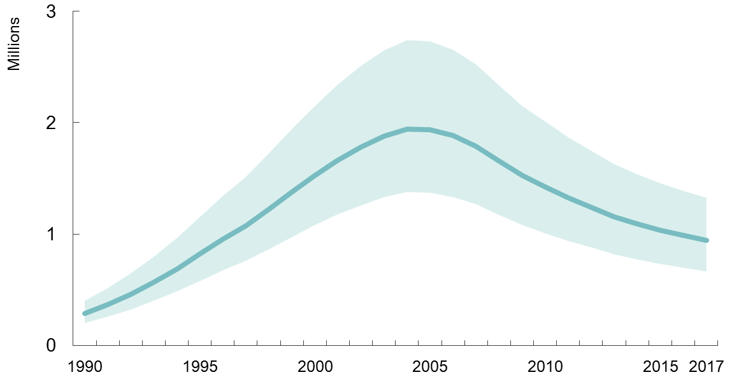
HIV deaths
Adult and child HIV deaths
Range of uncertainty
2017
940,000 deaths
(670,000–1.3 mn)
1980 to 2016
1980
4,224 deaths)
2016
1.03 million deaths
2005 to 2016
HIV deaths decreased by 45.8%
TB-related PLWHA deaths decreased 20.9%
2005
peak at 1.91 million deaths
Source: UNAIDS 2018
GBD 2016 Causes of Death Collaborators. Global, regional, and national age-sex specific mortality for 264 causes of death, 1980–2016: a systematic analysis for the Global Burden of Disease Study 2016. Lancet. 2017 Sep
Notes:
2017
940,000 deaths (670,000–1.3 mn)
1980 to 2016
1980: 4,224 deaths (95% UI 2842–6274)
2005: peak at 1.91 million deaths (1.81 mn to 2.01 mn)
2016: 1.03 million deaths (0.99 mn to 1·08 mn)
From 2006 to 2016
HIV/AIDS deaths decreased by 45.8% (95% UI 43.7–47.7)
1.91mn (1.81-2.00 mn) in 2006 → 1.03 mn (.987-1.08 mn) in 2016
TB-related PLWHA deaths decreased 20.9%
1.21 million deaths (95% UI 1.16 mn-1.27 mn) in 2016
1980 to 2016
1980
4,224 deaths (95% UI 2842-6274)
2005
peak at 1.91 million deaths
(1.81 mn to 2.01 mn)
2016
1.03 million deaths (0.99 mn to 1·08 mn)
From 2006 to 2016
HIV/AIDS deaths decreased by 45.8% (95% UI 43.7–47.7)
1.91mn (1.81-2.00 mn) in 2006 → 1.03 mn (.987-1.08 mn) in 2016
TB-related PLWHA deaths decreased 20.9%
1.21 million deaths (95% UI 1.16 mn-1.27 mn) in 2016
16 [Cited 2018 Jul 15]; 390(10100). Available from: https://www.ncbi.nlm.nih.gov/pmc/articles/PMC5605883/
Global age-standardised HIV/AIDS death rate decreased 52.8% (95% UI 51·0–54·4)
29.0 deaths (27.6–30.3) per 100,000 in 2006 → 13.7 deaths (13.1–14.3) per 100 000 in 2016

Slide 31
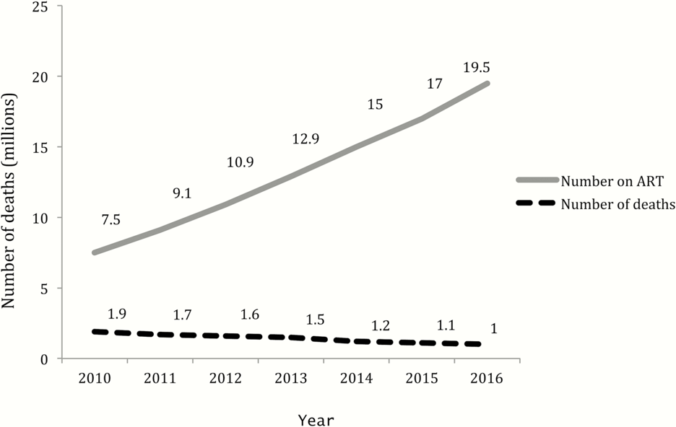
Number of deaths as ART increases
Source: Calmy A, Ford N Meintjes G. The Persistent Challenge of Advanced HIV Disease and AIDS in the Era of Antiretroviral Therapy. Clinical Infectious Diseases [Online]. 2018 Mar 4 [Cited 2018 Jul 15];66(Suppl 2). Available from: https://doi.org/10.1093/cid/cix1138
Notes:
Number of patients receiving ART and number of deaths.
that an increasing proportion of people with very advanced HIV disease are ART experienced, and in this study increased from 14.3% in 2008 to 56.7% in 2017

Slide 32
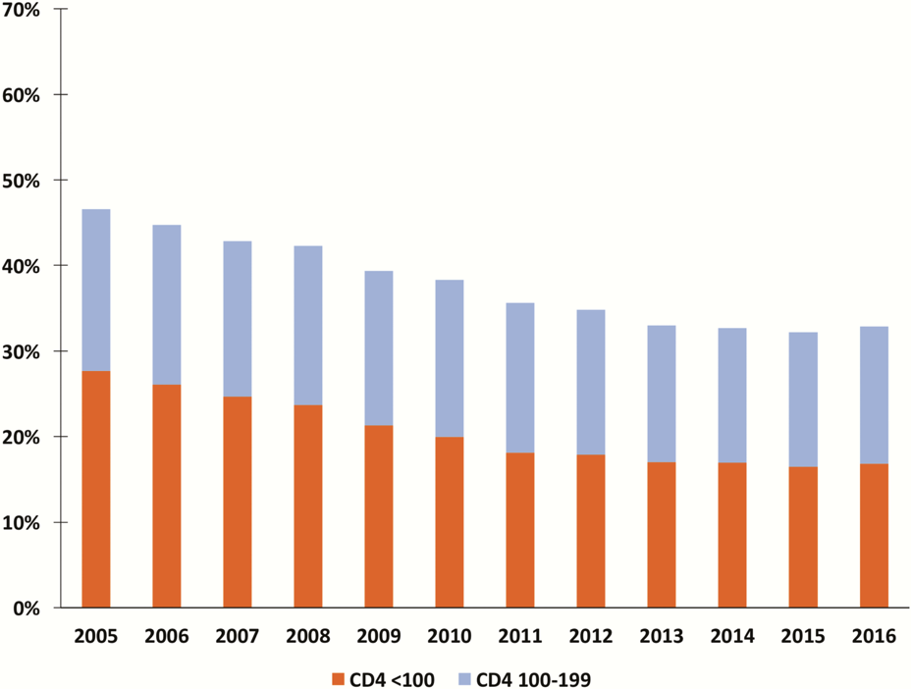
Low CD4 at initiation
South Africa
PLWHA presenting with advanced HIV disease has remained unchanged over the last 5 years
More than a third of patients enter care with a CD4 cell count <200 cells/µL.
  Men almost twice as likely as women (23.1% vs 12.6% ) to enter care with very advanced HIV disease
Need to support rapid identification and treatment initiation
Source: Carmona S, Bor J, Nattey C, et al. Persistent high burden of advanced HIV disease among patients seeking care in South Africa’s National HIV program: Data from a nationwide laboratory cohort. Clin Infect Dis [Online]. 2018 Mar 4 [Cited 2018 Jul 13 ];66(Suppl 2). Available from: https://academic.oup.com/cid/article/66/suppl_2/S111/4918994?searchresult=1
Notes:
Carmona S, Bor J, Nattey C, et al. Persistent high burden of advanced HIV disease among patients seeking care in South Africa’s National HIV program: Data from a nationwide laboratory cohort. Clin Infect Dis [Online]. 2018 Mar 4 [Cited 2018 Jul 13 ];66(Suppl 2). Available from: https://academic.oup.com/cid/article/66/suppl_2/S111/4918994?searchresult=1
Enduring and substantial burden of advanced HIV

Slide 33
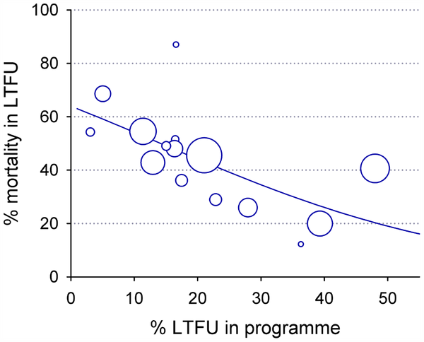
LTFU and RIP
17 studies, 6,420 ppl on ART
“Substantial minority” of LTFU adults cannot be found
The combined mortality was 40% (95% confidence interval 33%–48%),
Mortality “inversely associated” with LTFU rates: as LTFU rates increased, RIP among LTFU fell
  20% to 60% LTFU died as the percentage of patients LTFU increased from 5% to 50%
Brinkhof MW, Pujades-Rodriguez M, Egger M. Mortality of Patients Lost to Follow-Up in Antiretroviral Treatment Programmes in Resource-Limited Settings: Systematic Review and Meta-Analysis. PLOS ONE [Online].2009 Jun 4.
Notes:
Brinkhof MW, Pujades-Rodriguez M, Egger M. Mortality of Patients Lost to Follow-Up in Antiretroviral Treatment Programmes in Resource-Limited Settings: Systematic Review and Meta-Analysis. PLOS ONE [Online].2009 Jun 4 [Cited 2018 Jul 15]. Available from: http://journals.plos.org/plosone/article?id=10.1371/journal.pone.0005790
In ART programmes in resource-limited settings a substantial minority of adults lost to follow up cannot be traced, and among those traced 20% to 60% had died.

Slide 34
Diagnosing TB in HIV+ pregnant women
Symptom screening not good enough for HIV+ pregnant women
  Symptom screening 90.1% sensitivity
  But among HIV+ pregnant women (RSA) dropped to 28%
a cluster-randomised trial to compare universal sputum TB testing with standard symptom-based testing in this population.
The majority of women with previously undiagnosed prevalent TB were asymptomatic.
Universal TB screening of all HIV+ pregnant women increased case detection 10-fold
MGIT identified more TB than Xpert in women whose pregnancy may mask TB symptoms.
Our data support sputum testing all HIV-infected pregnant women for TB in high burden
Xpert detected one third the rate of TB compared with MGIT
Martinson N et al. Universal sputum testing vs symptom-based testing for tuberculosis (TB) in HIV infected pregnant women: a cluster-randomised implementation trial in South Africa. 9th IAS Conference on HIV Science. 23–26 July 2017. Paris. Poster abstract TUPDB0204LB.
Hoffman CJ, Variava E, Rakgokong M, et al. High Prevalence of Pulmonary Tuberculosis but Low Sensitivity of Symptom Screening among HIV-Infected Pregnant Women in South Africa. PLOS ONE [Online]. 2013 Apr 17
Notes:
Hoffman CJ, Variava E, Rakgokong M, et al. High Prevalence of Pulmonary Tuberculosis but Low Sensitivity of Symptom Screening among HIV-Infected Pregnant Women in South Africa. PLOS ONE [Online]. 2013 Apr 17 [Cited 2018 Jul 15]. Available from: https://doi.org/10.1371/journal.pone.0062211
Martinson N et al. Universal sputum testing vs symptom-based testing for tuberculosis (TB) in HIV infected pregnant women: a cluster-randomised implementation trial in South Africa. 9th IAS Conference on HIV Science. 23–26 July 2017. Paris. Poster abstract TUPDB0204LB. [Cited 2018 Jul 15]. Available from: http://programme.ias2017.org/Abstract/Abstract/5746
I-base. Screening HIV positive pregnant women for TB in South Africa increased detection by 10-fold. 2017 November. IAS 9 Paris 2017. HTB. Available from: http://i-base.info/htb/32955

Slide 35
Swaziland: TB decreased as ART coverage increased
––– TB cases x 100
––– ART coverage %

Slide 36
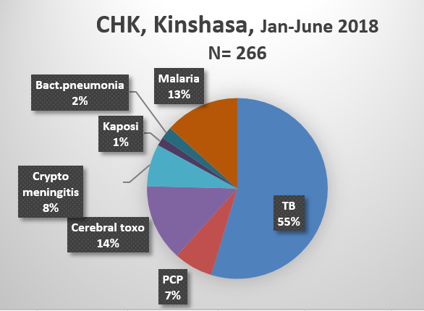
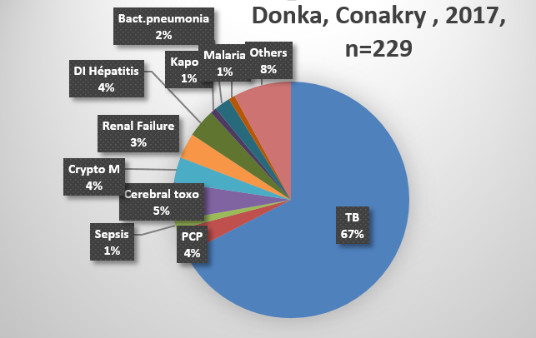
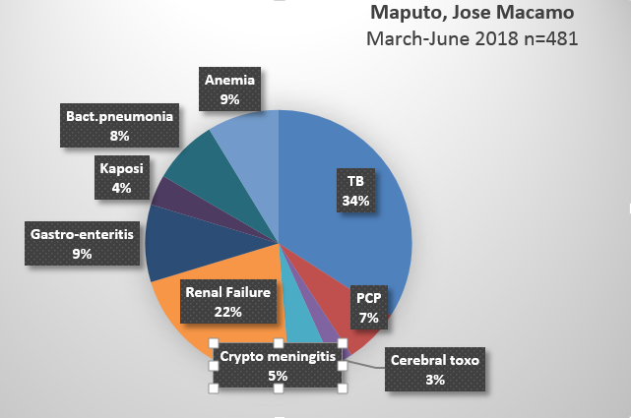
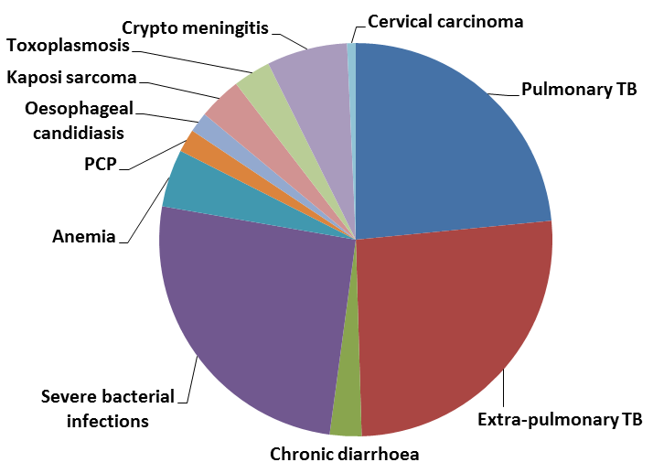
Most common causes of HIV related mortality ( %) and CFR .
Kinshasa, Conakry , Maputo 2018
Cd4 & IPD mortality: Cd4 is
Notes:
EC: Overview of causes of mortality = TB is the MAIN cause still
Importance to stress difference in mortality causes which illustrate difficulties to establish a primary cause of death

Slide 37
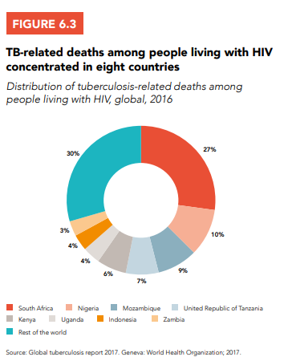

Slide 38
LTFU known to have died
Fox & Rosen systematic review
1,554,773 PLWHA on ART, 42 countries, 2008-2013
Retention at 36 months was 65-70%
  65% in Africa
  80% in Asia
  64% in Latin America and the Caribbean
43% of all PLWHA on ART “not retained were known to have died”
Fox MP, Rosen S. Retention of Adult Patients on Antiretroviral Therapy in Low- and Middle-Income Countries: Systematic Review and Meta-analysis 2008–2013. J Acquir Immune Defic Syndr [Online]. 2015 May 1
Notes:
Fox MP, Rosen S. Retention of Adult Patients on Antiretroviral Therapy in Low- and Middle-Income Countries: Systematic Review and Meta-analysis 2008–2013. J Acquir Immune Defic Syndr [Online]. 2015 May 1 [Cited 2018 Jul 15];69(1). Available from: https://www.ncbi.nlm.nih.gov/pmc/articles/PMC4422218/pdf/nihms657470.pdf

